Slide 1
Let’s Build A Simple Web Server From Scratch
Kevin Griffin
@1kevgriff – linkedin.com/in/1kevgriff

Slide 2
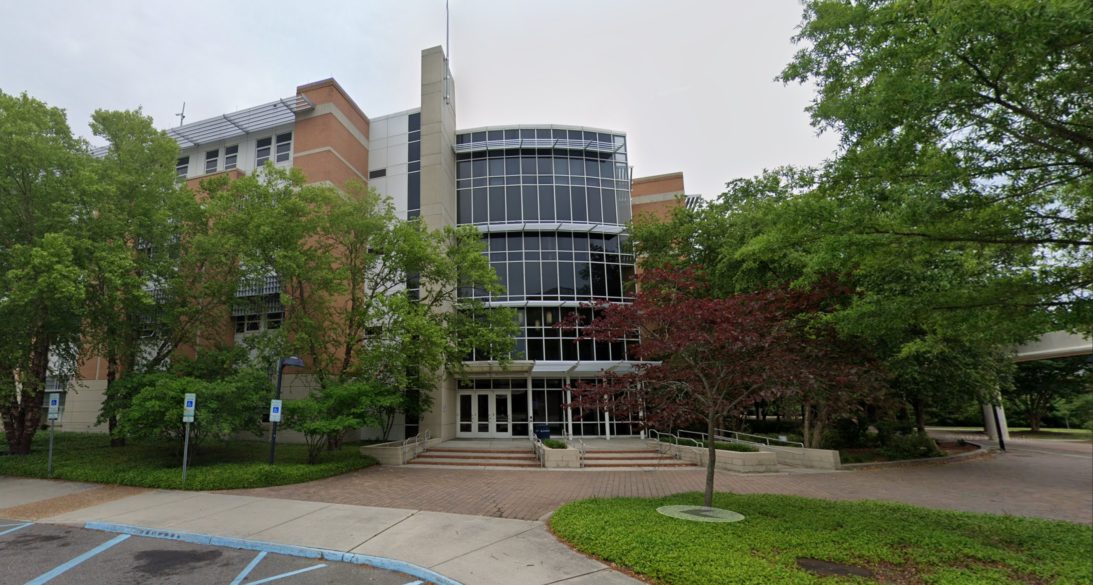

Slide 3
The CS 431/531 Web Server Design course focuses on complete understanding of the Hypertext Transfer Protocol (HTTP) and implementation of a web server (not a web application). The course is programming intensive, prerequisites include the understanding of network (socket) programming. Students in this course decide their own implementation language within the Unix/Linux environment; the lectures are about HTTP and not about any particular programming language.
CS 431/531

Slide 4

Hi, I’m Kevin

Slide 5
Kevin Griffin 14-time Microsoft MVP ASP.NET Core, Azure, and Web consultwithgriff.com twitter.com/@1kevgriff bbiz.io/@1kevgriff

Slide 6
Client
Server
6

Slide 7
Client
Server
Request
Response
7

Slide 8
Client
Server
Request
Response
A client sends an HTTP request to a server in the form of a request message, beginning with a request-line that includes a method, URI, and protocol version (Section 3.1.1), followed by header fields containing request modifiers, client information, and representation metadata (Section 3.2), an empty line to indicate the end of the header section, and finally a message body containing the payload body (if any, Section 3.3).
RFC-7230
8

Slide 9
Client
Server
Request
Response
A server responds to a client's request by sending one or more HTTP response messages, each beginning with a status line that includes the protocol version, a success or error code, and textual reason phrase (Section 3.1.2), possibly followed by header fields containing server information, resource metadata, and representation metadata (Section 3.2), an empty line to indicate the end of the header section, and finally a message body containing the payload body (if any, Section 3.3).
RFC-7230
9

Slide 10
RFCs
Request for Comments
Drafts by working groups of computer scientists and practicioners on agreed ways things should work
RFC 7230: (HTTP/1.1): Message Syntax and Routing
RFC 7231: (HTTP/1.1): Semantics and Content
10

Slide 11
RFC 9114
What about
HTTP/2 or HTTP/3?
RFC 7540
11

Slide 12
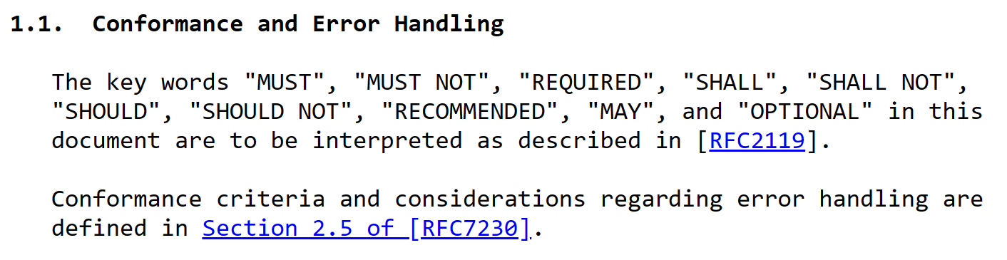
RFC Terminology
12

Slide 13
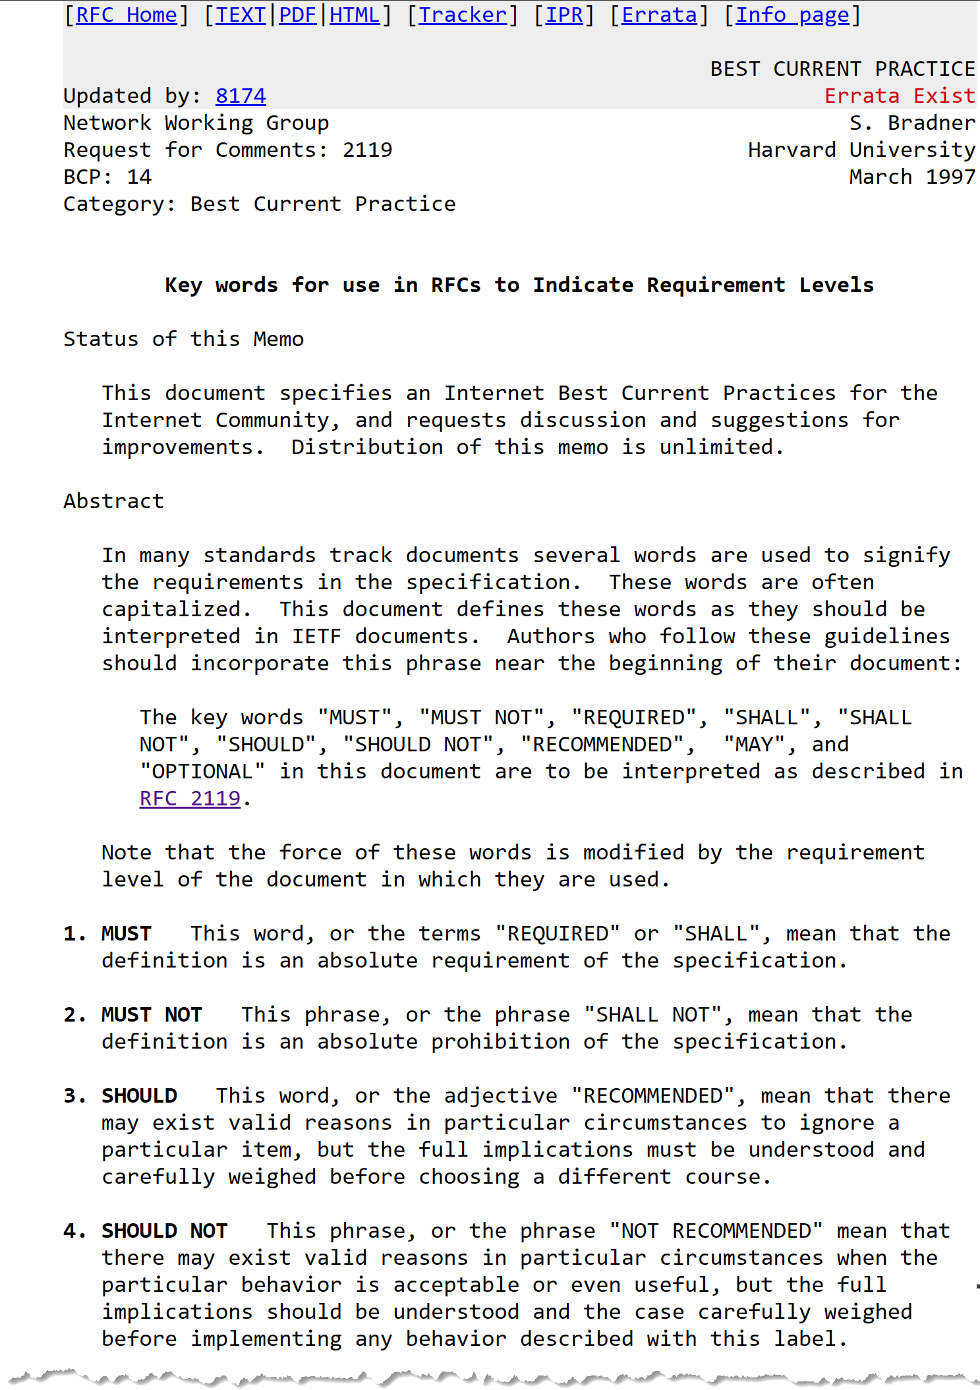

Slide 14
Lesson Learned: Not all existing implementations obey the RFC
14

Slide 15
Client
Server
SOCKET
SOCKET
0100011101000101010101000010000000101111001000000100100001010100010101000101000000101111001100010010111000110001
GET / HTTP/1.1
15

Slide 16
Client
Server
SOCKET
SOCKET
HTTP/1.1 200 OK
010010000101010001010100010100000010111100110001001011100011000100100000001100100011000000110000001000000100111101001011
16

Slide 17
Anatomy of a Request
17

Slide 18
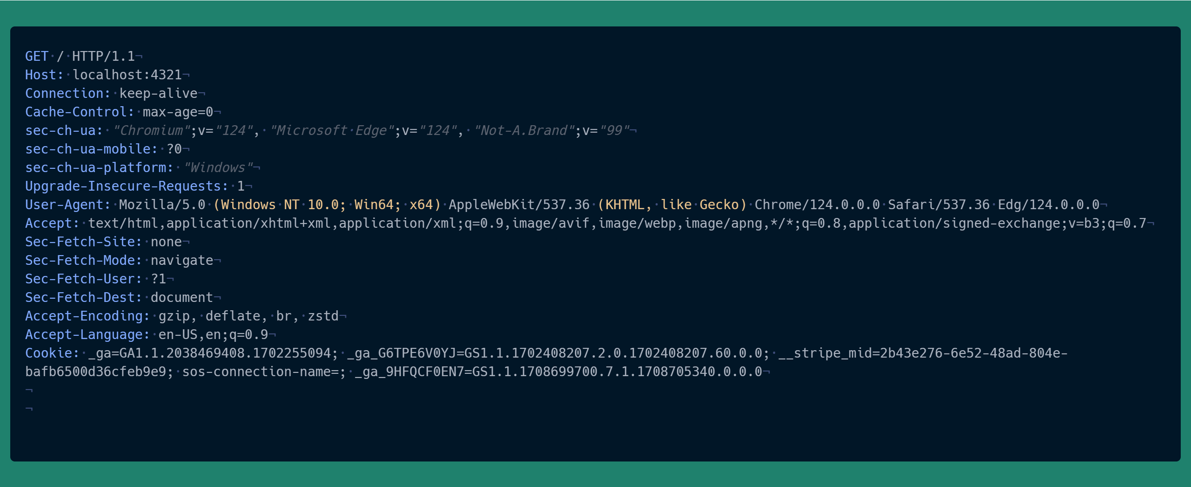
18
Notes:
SEC-FETCH-* == RFC 8484

Slide 19
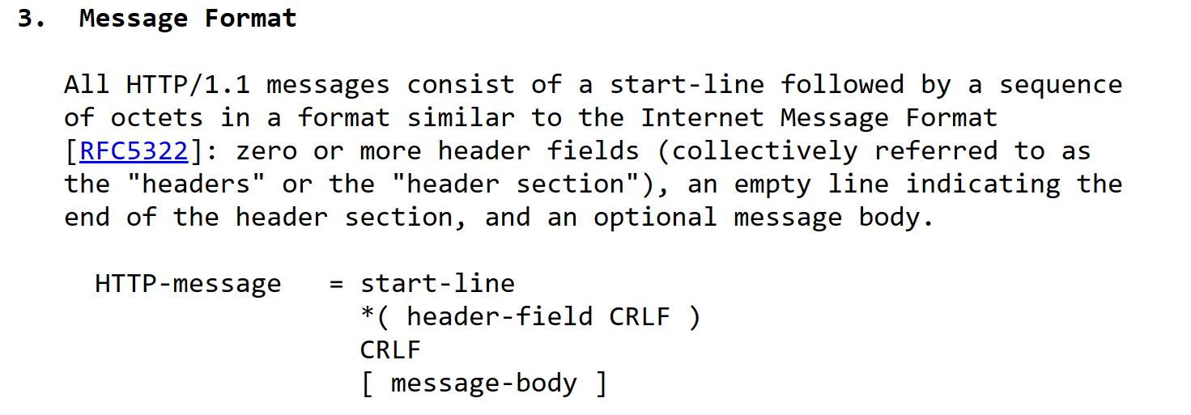

19

Slide 20
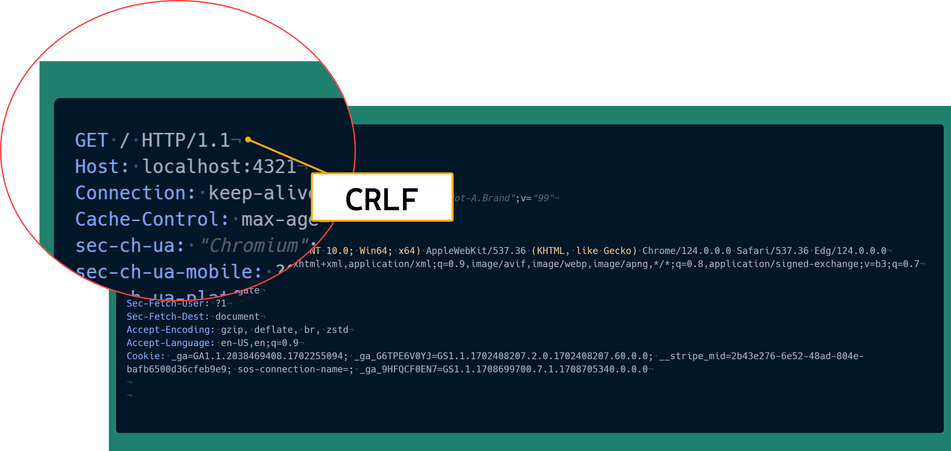
20
Notes:
There is no described length of the start line.

Slide 21

21

Slide 22
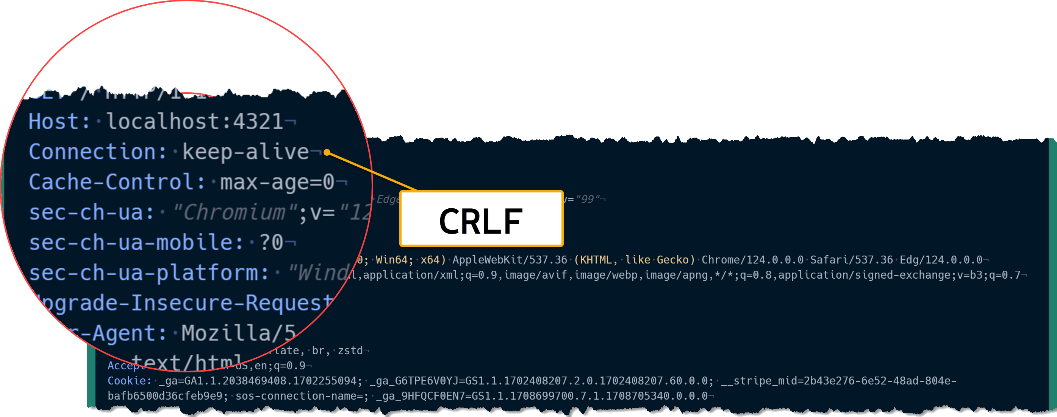
22

Slide 23
What headers are required?
23

Slide 24
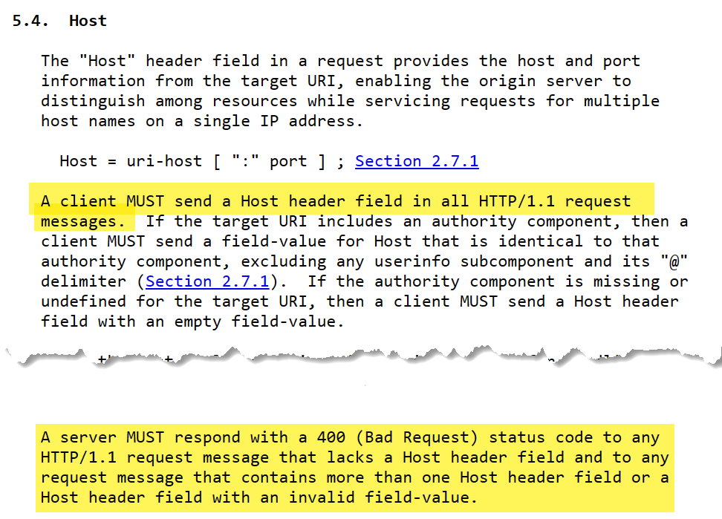
24

Slide 25
25

Slide 26
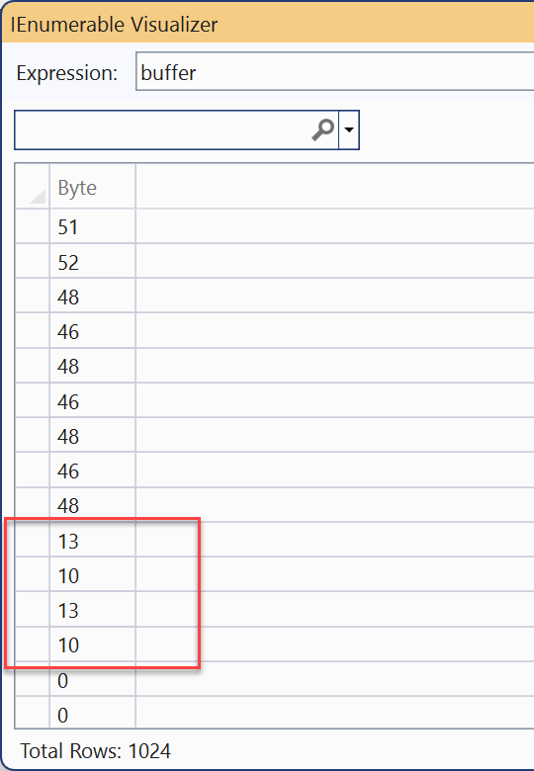
26

Slide 27
Lesson Learned: Web Servers and Clients are really forgiving against
27

Slide 28
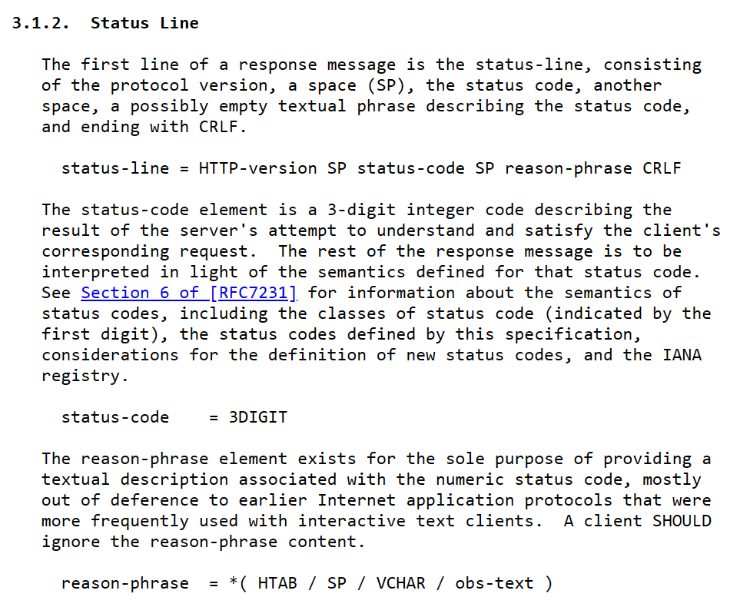
28

Slide 29
Response Time!
29

Slide 30
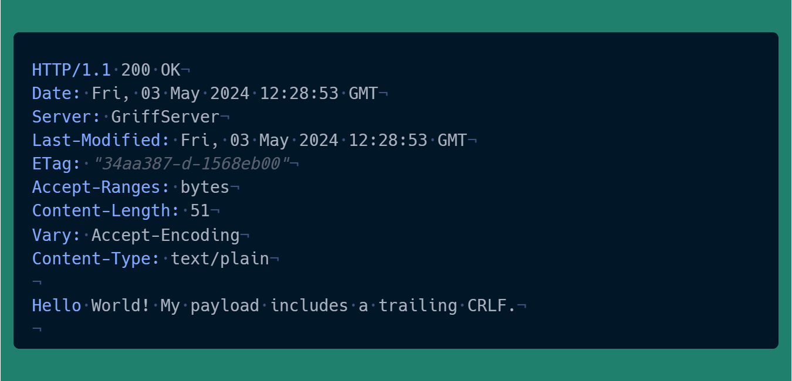
30

Slide 31
Demo: Simple HTTP with C#
31

Slide 32
Accept
32

Slide 33
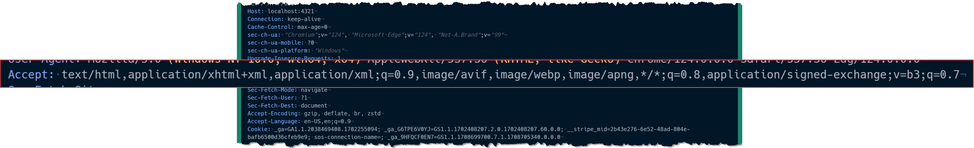

Slide 34
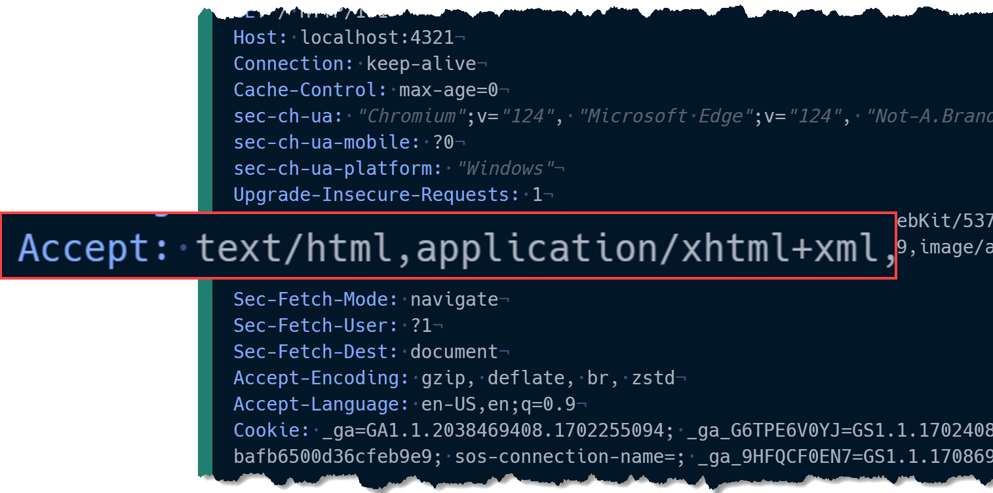
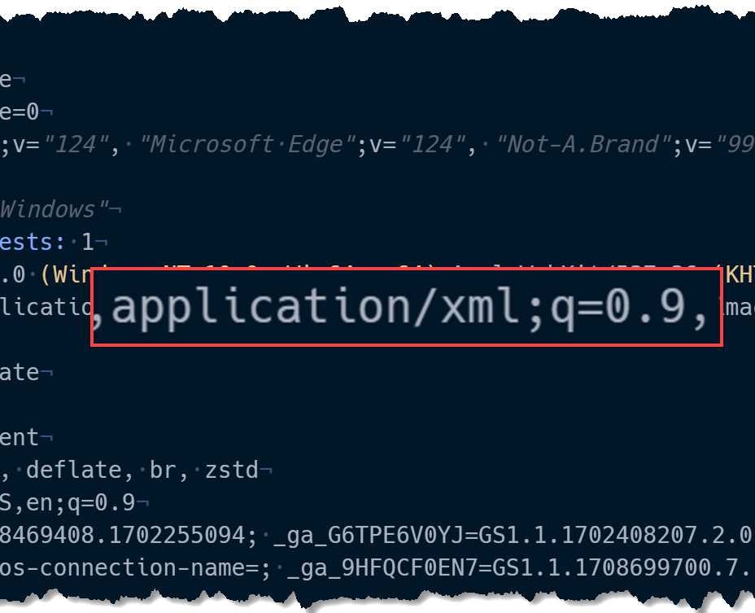

Slide 35
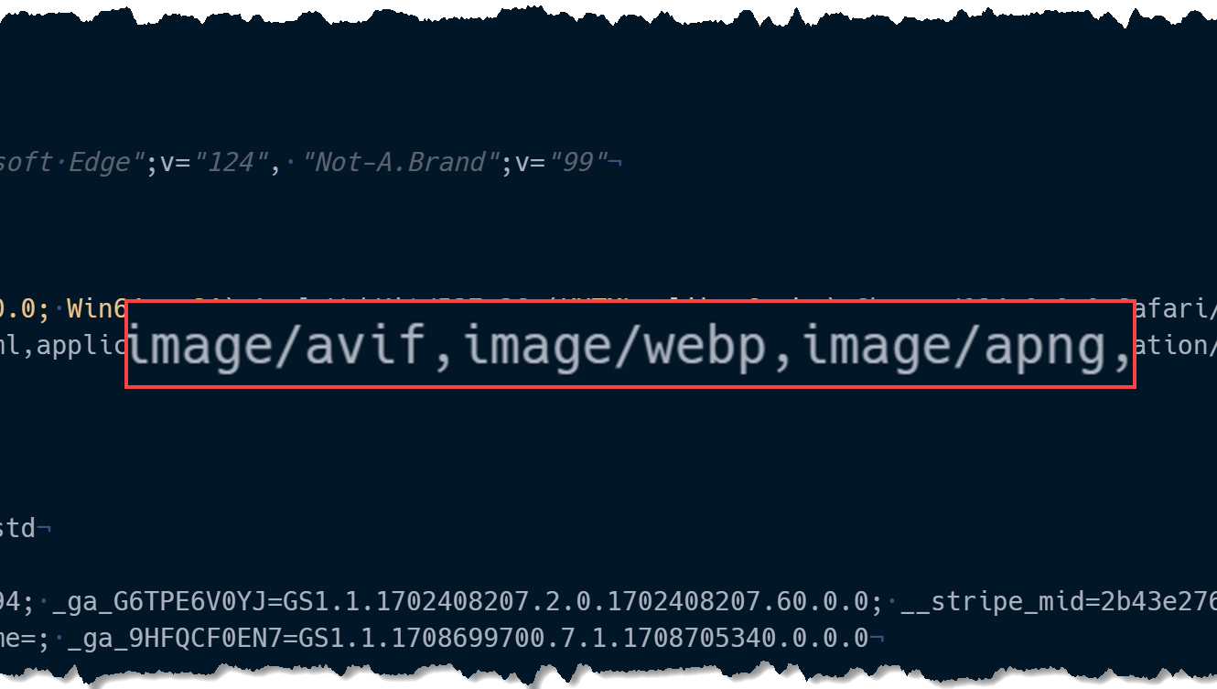
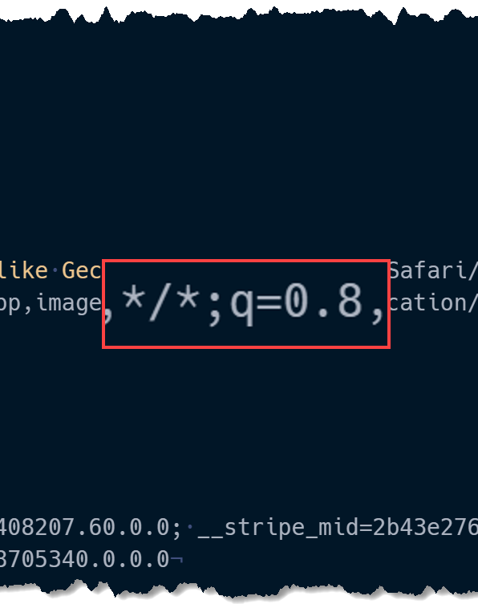

Slide 36
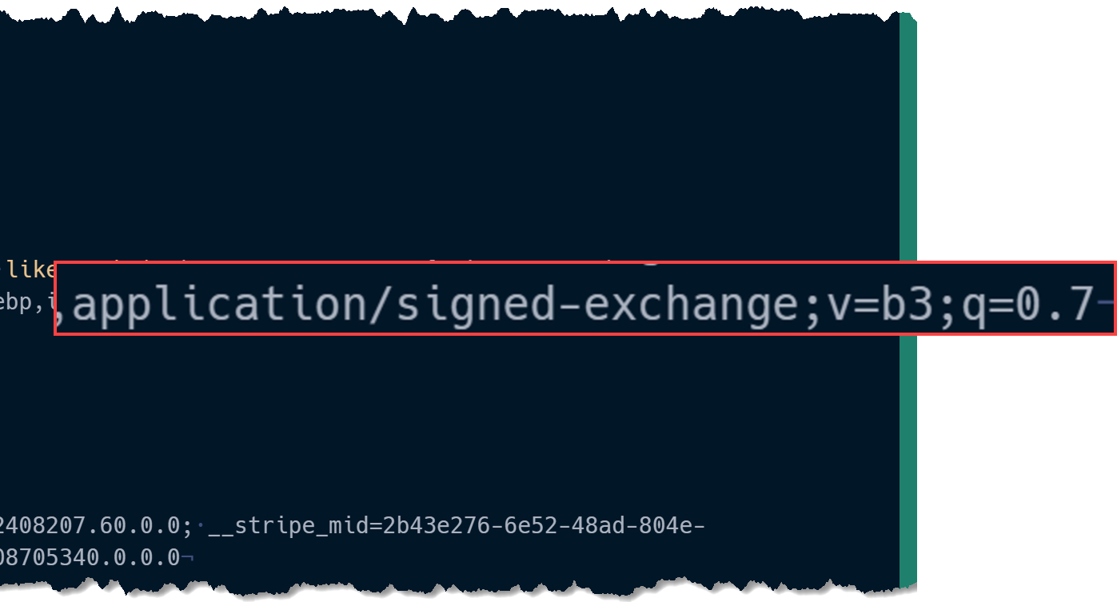
Notes:
application/signed-exchange;v=b3: A signed exchange allows browsers to verify the origin of a document independently from its delivery. The v=b3 parameter specifies the version of signed exchange being used, and the q=0.7 indicates its quality preference is lower compared to the other specified types.
The concept of application/signed-exchange is indeed documented in the Internet Engineering Task Force (IETF) drafts, specifically in the draft titled "Signed HTTP Exchanges". This is not a finalized RFC, but rather a draft that outlines how to prove the authenticity of a resource independent of its transport layer, aiming to standardize the way exchanges are signed. It includes details on creating signatures for HTTP exchanges, which then allow these exchanges to be considered authoritative for an origin, even if they are transferred over a connection that isn't authoritative for that origin​ (IETF Datatracker)​.

Slide 37
Accept-Encoding
37

Slide 38
Deflate
Widely supported
Gzip
Widely supported
Brotli
Best compression
Slower than Deflate and Gzip
Better compression
Meh compression
Zstd
High performance
Tunable speed
Growing support

Slide 40
Where do we go from here?
40

Slide 41
Client
Server
Request
Response
Request
Response
Request
Response
41
Notes:
Multithreading!

Slide 42
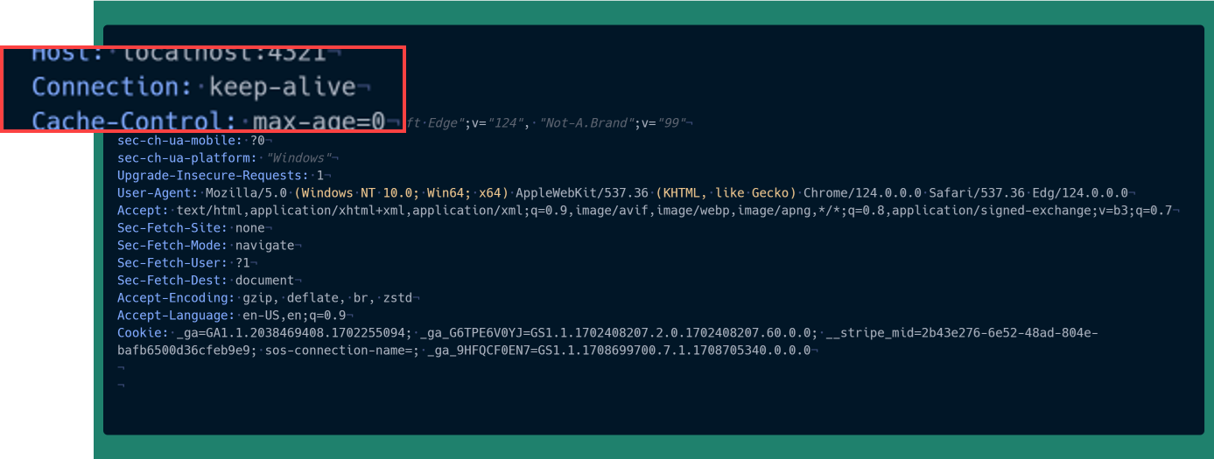

Slide 43
Client
Server
Request
Response
Request
Response
43
Notes:
Multithreading!

Slide 44
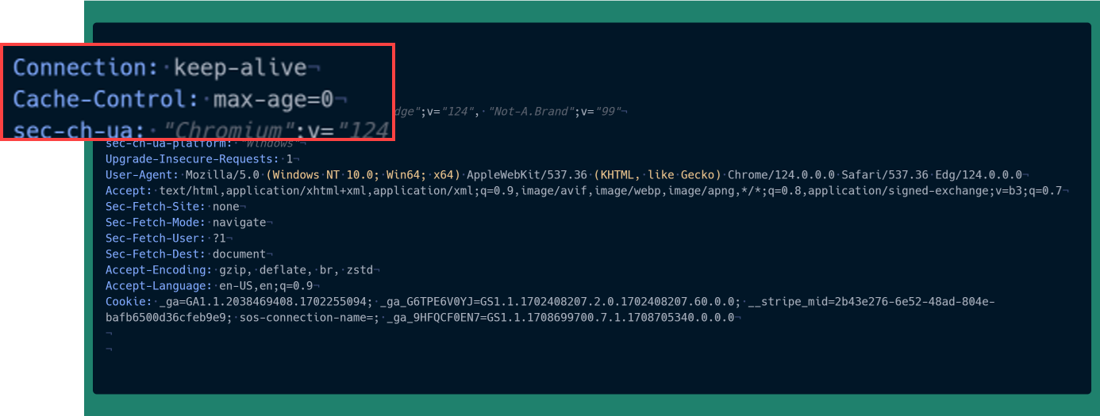
Client
Server
Cache
Request
Response
Request
Response
Request
Response
44
Notes:
Multithreading!

Slide 45
45

Slide 46
Thanks!

